Slide 1
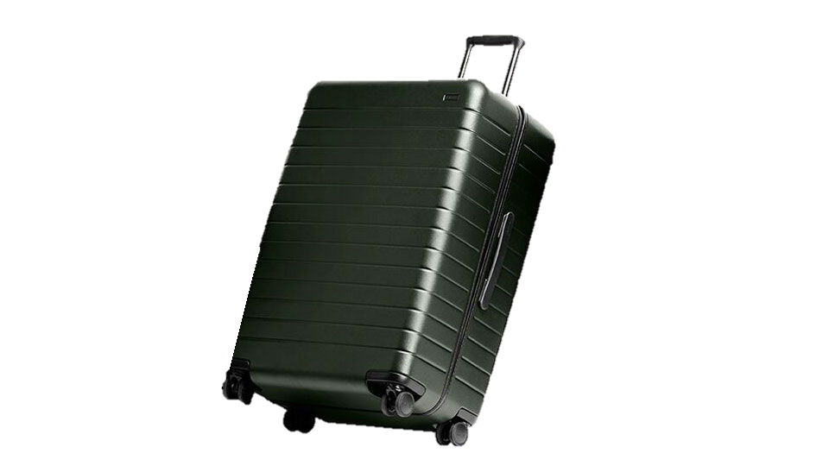
Future in a Box

Slide 2
Background & Challenge
TURKEY is located in an earthquake zone and had the biggest earthquake of its history 3 months ago.
3,6 M
Students. 2,8 M is
assumed to be in the area
Speed-up lessons for summer launched
.
Government already launched a curriculum for the summer through EBA.
Buildings cannot be entered
When there is no building there are no connectivity, electricity or equipment.
Time is ticking
We need to find a fast solution for the continuity of education!

Slide 3
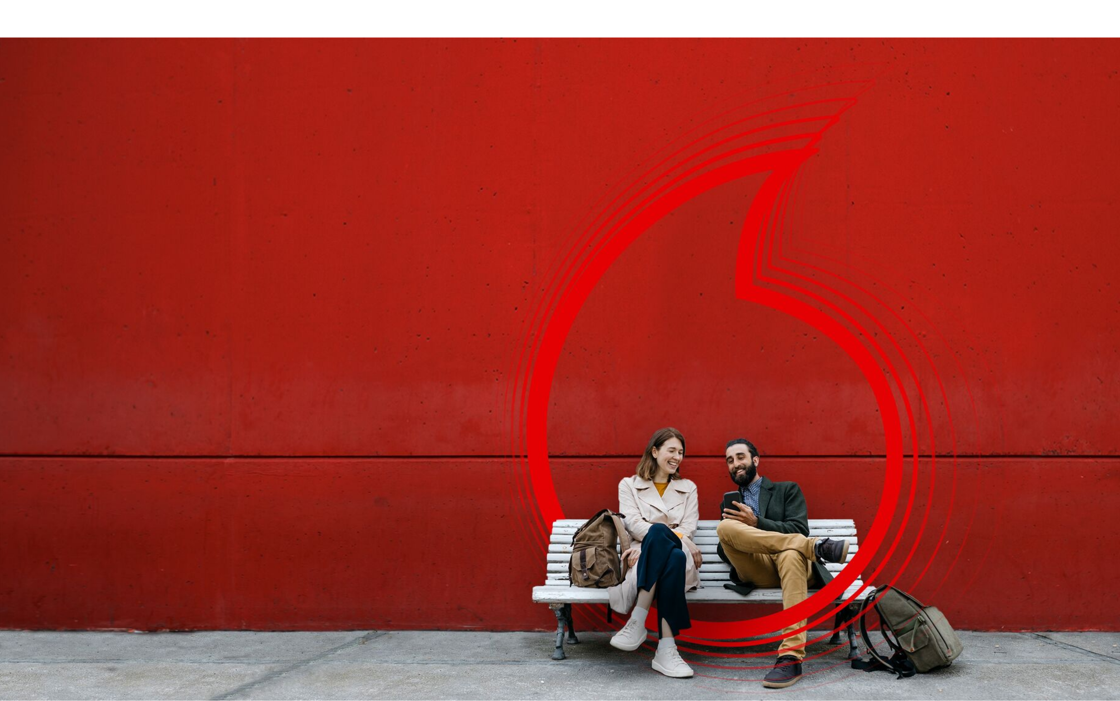
Vodafone Business
Together We Can Build a Better Future for All

Slide 4
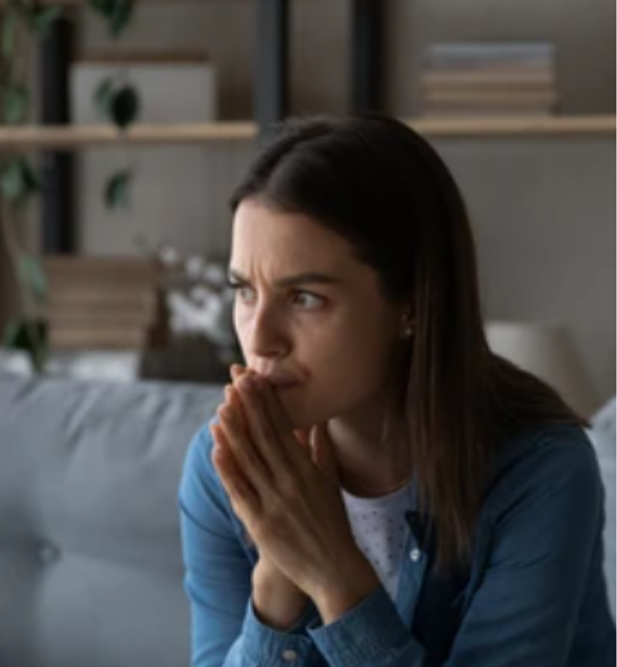
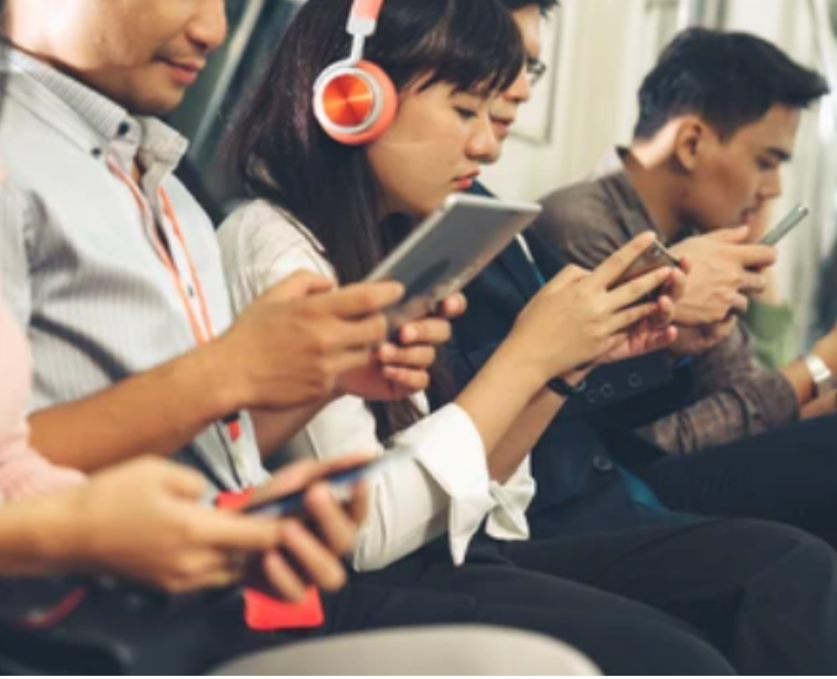
Audience & Insights
Nationwide campaign. This earthquake affected all of us. Our relatives, friends, old acquaintances harmed or even died.
“I want to help the children but I don't know exactly how"
’
"I donate but I don't trust that my money is used in the right / needed places"
"Even though earthquake happened 3 months ago, I don’t actively think about it. Agenda of the country changes so fast. I don't see it on any media any more."

Slide 5
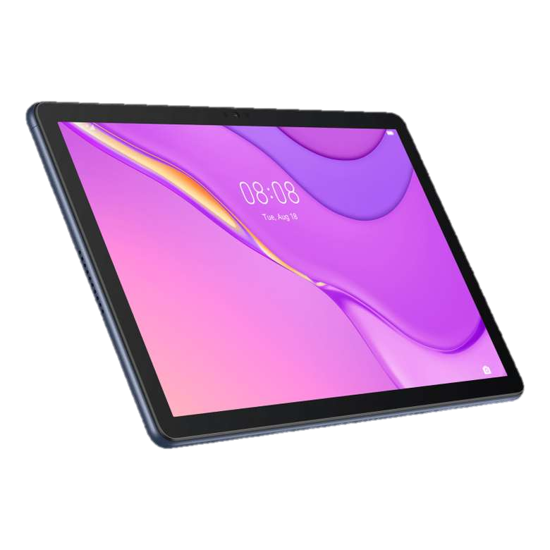
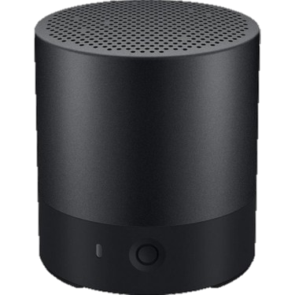
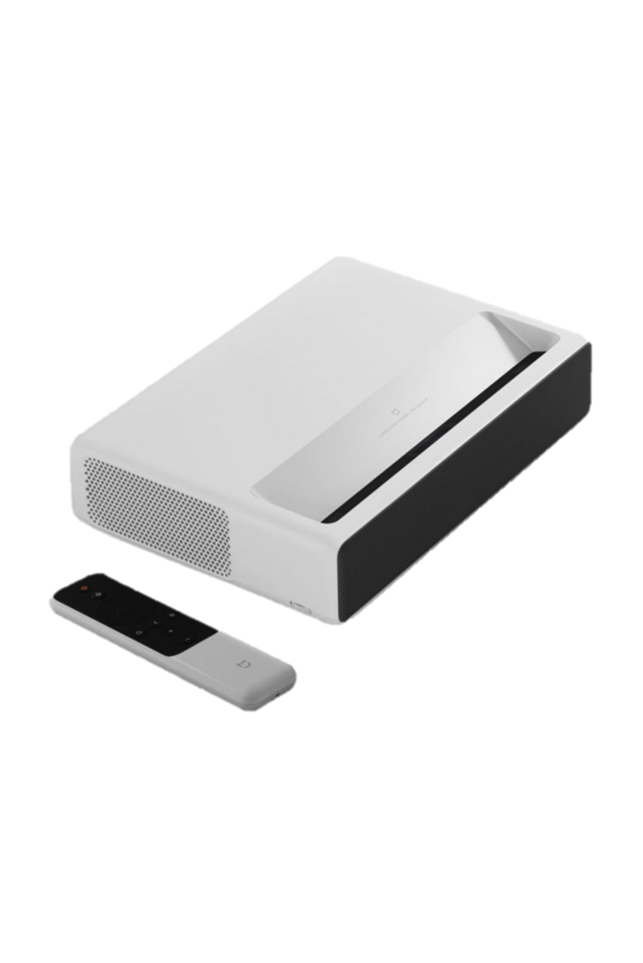
Our Solution
x25
We will collaborate with our global partners Huawei & Microsoft,
Together We Can Build a Better Future for All.
MEB's EBA
Application
Future in a Box
Group's Connected
Education Lessons
Portable connectivity, electricity and equipment needs of a classroom.
Online Coding
Courses
Online
Psychological
Support System

Slide 6
Key Message
Journey
Saving the future of the nation only for 60 TL /month
01.
02.
Shareable & collaborative
Digital Platform "Connected Education"
•Subscription based
•Donation for 60 TL / month
•VF & partners donates x2 for each donation
04.
03.
•Matching donators and students anonymously
•Tracking improvements form the platform
•Monthly Report of the Future,
•Visualize closing gap of the educational loss.
Through Vodafone Foundation and Habitat boxes
will be distributed to the Container / Tent Villages

Slide 7
Key Differentiation Points
Plug & Play Solution
Reusable & Portable Solution
10 minutes
72 hours
With a teacher and students anywhere can be a school
Education system can be up and running again after any disaster
Continuous & Assuring Donation
Global Support
By creating emotional link between students and donators, the impact of donation can be seen to motivate donators continue to help
With Vodafone Group's existing online education lessons localization and Vodafone Foundations Coding Lessons we have a ready to use platform

Slide 8
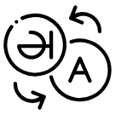
Deliverables & KPIs
Time
Plan
27.04.2023
10.05.2023
17.05.2023
19.05.2023
23.05.2023
28.05.2023
01.06.2023
Creative Brief
De-brief
KV, Slogan,
Hashtag
Translation of global content for connected education
Micro website,
of the platform,
Mailings
Digital, Media,
Print, Gerilla
Marketing Strategy
Launch
Budget
Production
(including all digital & Offline designs; application, website etc.)
Media Spending
(TV, Digital, PR, Influencer Marketing.)
2.500.000 TL
15.000.000 TL
KPI's
ATL (1month)
90%
40 M
Awareness
Score
Total
Reach
Being
Lovemark
KPI's
Fund Raising (6months)
6,5 M
2.955 M
Total Unique
Donators
Total
Donation
79%
Reach rate of the
needed students

Slide 9
What We
Want?
Strong communication and media plan with gerilla marketing
Creative idea that will create national awareness on education
Personality: Sincerity, Competence
Impact
We Want
Nationwide awareness and movement
Government to increase funds in this area
Best case for VF group to spread the solution globally.
Future in a Box
Results
We Want
Education system to be up and running fast
Close the gap of education to save the nation's future.
Continuity of donations

Slide 10
Back-up
One off Costs | Sponsor | Price per Box |  | Fund Raising | 1st month | 2nd month | 3rd month | 4rd month | 5th month | 6th month
Devices / Terminal | Huawei | 20.000 |  | Unique donator in a month | 3.000.000 | 3.500.000 | 4.000.000 | 4.750.000 | 5.500.000 | 6.500.000
Devices / Terminal | Donation | 13.000 |  | Total application from donators | 5.000.000 | 7.000.000 | 8.250.000 | 8.750.000 | 9.250.000 | 11.000.000
Solar Energy Charge System | Donation | 20.000 |  | Total Donation Raised | 300.000.000 | 420.000.000 | 495.000.000 | 525.000.000 | 555.000.000 | 660.000.000 | 2.955.000.000
Logistics | Donation | 1.000
Total One off Costs |  | 54.000
Monthly Reccuring Costs | Sponsor | Price per Box |  | Results | 1st month | 2nd month | 3rd month | 4rd month | 5th month | 6th month
Red Box (mobile connectivity) | Vodafone | 500 |  | Number of boxes that can be purchased | 8.824 | 12.353 | 14.559 | 15.441 | 16.324 | 19.412 | 86.912
Satellite Back-up | Vodafone | 1.500 |  | Total Students Reached | 220.588 | 308.824 | 363.971 | 386.029 | 408.088 | 485.294 | 2.172.794
Software | Microsoft | 300
Total Monthly Rec. Costs |  | 2.300 |  | Total students in need in the area | 2,8
1 Year usage |  | 27.600 |  | Total students covered | 2,2
 |  |  |  | Reach Rate | 79%
Total Cost of a Box for a Year |  | 81.600
Total Donation Needed |  | 34.000
Donation Per Application |  | 60
Nuber of donation needed per box |  | 567
Operational Journey
01.
02.
03.
04.
05.
When the cost of one box is collected, the portable BOX will ship to the zone.
Through Vodafone Foundation and Habitat it will be distributed to the Container / Tent Villages
Tabloids will be assigned to the students by the teachers.
Teachers and student will access online curriculum and psychological support through the platform.
Weekly online assessments to guide teachers the topics to be focused on to decrease the education gap.

